Slide 1
WELCOME
To
Training Programme
in
MATLAB

Slide 2

To Get into MATLAB
Double-click the
MATLAB Icon

Slide 3
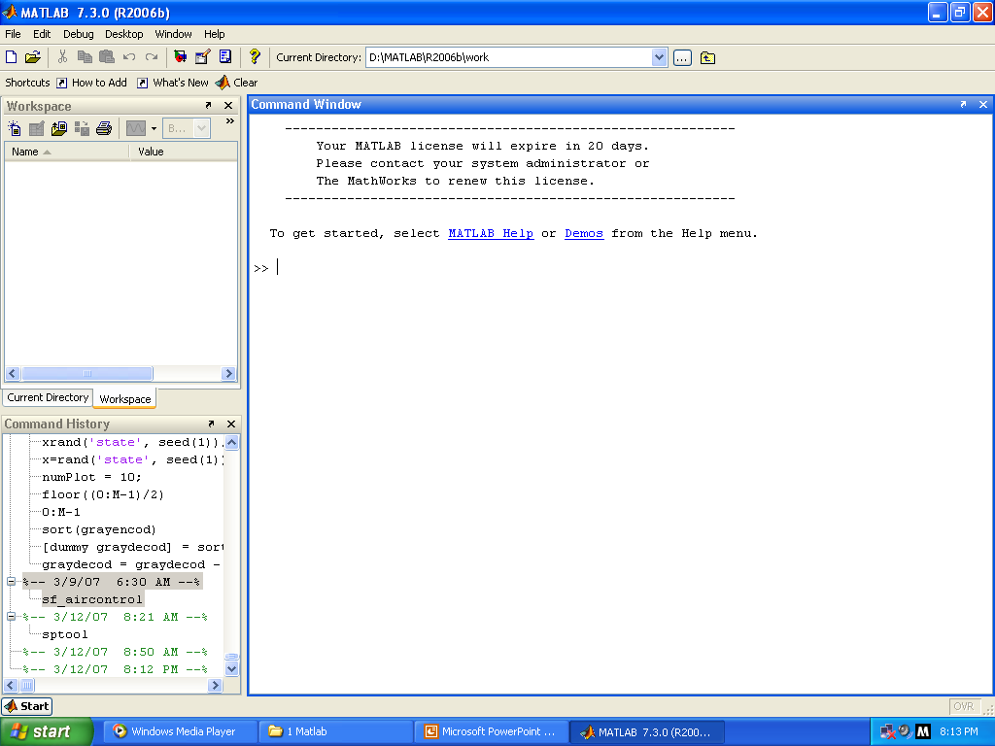
MATLAB Desktop Appears as shown below

Slide 4
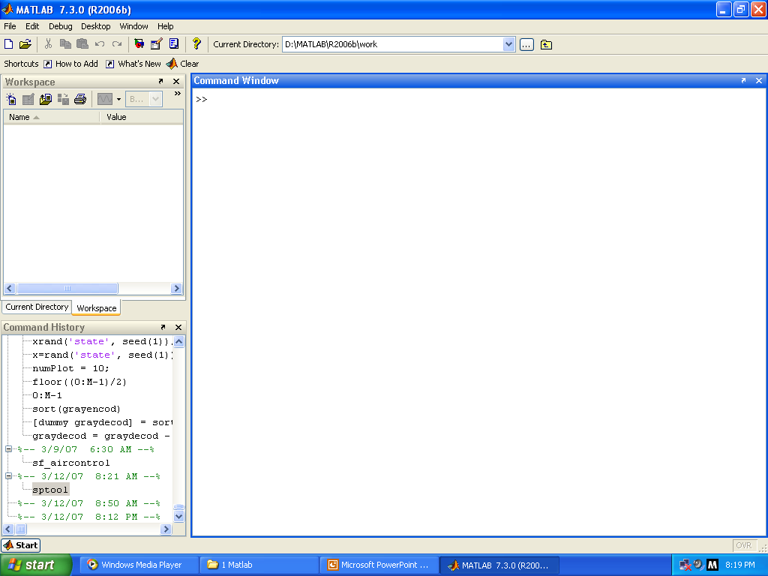
MATLAB Desktop
CommandWindow
Command prompt
Enter the
matlab functions/
commands here
Workspace Window where your
variables reside
Command history Window
records the functions
you run in the
command window

Slide 5
Command Window (Contd..)
This is the main window. All commands & functions are to be typed at the command prompt ‘>>’

Slide 6
To understand the working of MATLAB
Let us take a simple problem with the following data:-
Articles | Numbers | Cost/item
Eraser | 4 | 25
Pad | 6 | 52
Tape | 2 | 99
Let us Calculate the following:
Total number of item
Total cost of item purchased
Average cost of item

Slide 7
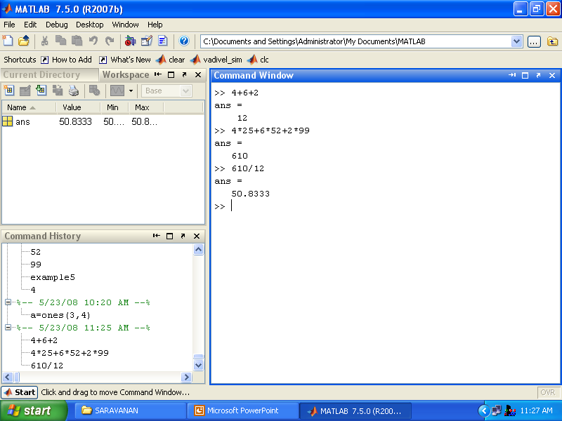
Let us first use MATLAB as a Calculator
To calculate the total number of item
Matlab arithmetic operators
To calculate the total cost of item
To calculate the average
* MATLAB calls the variable ‘ans’, which is short form of answer

Slide 8
Clearing the COMMAND Window
Syntax
clc
Description:
clc clears all input and output from the Command Window display, giving you a "clean screen"

Slide 9
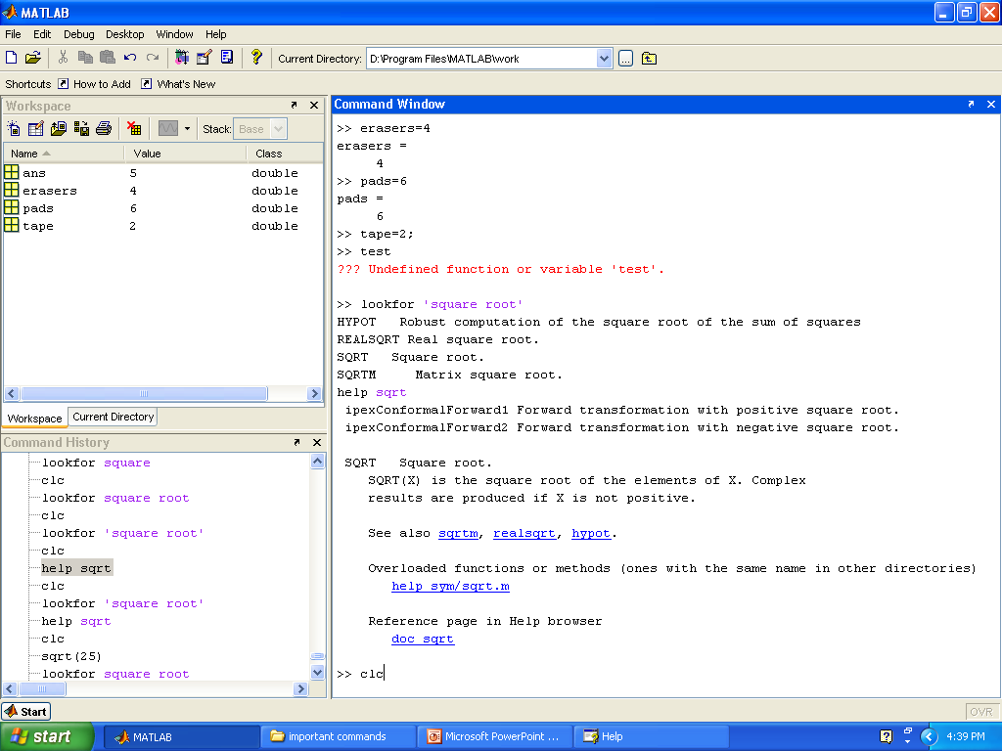
Before clearing
the command window
Enter clc here to
clear the above window

Slide 10
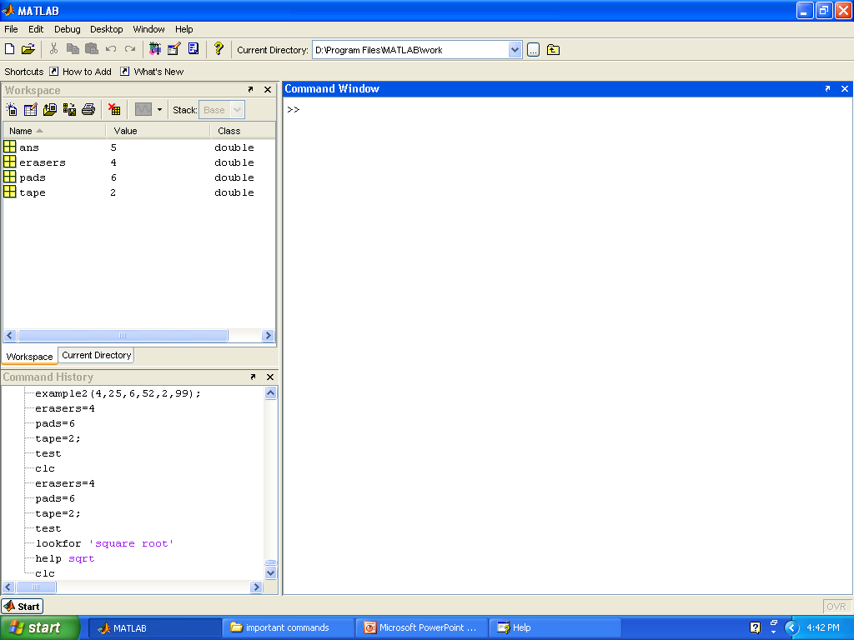
After ‘clc’ the command window appears as shown below
After clc
Before using ‘clear’
the work space is shown

Slide 11
Clearing the Workspace
Syntax
clear
Description:
clear removes all variables from the workspace. This frees up system memory.
clear ‘name’ removes just the M-file or MEX-file function or variable name from the workspace.

Slide 12

Enter clear here to
clear all variables in
the workspace

Slide 13
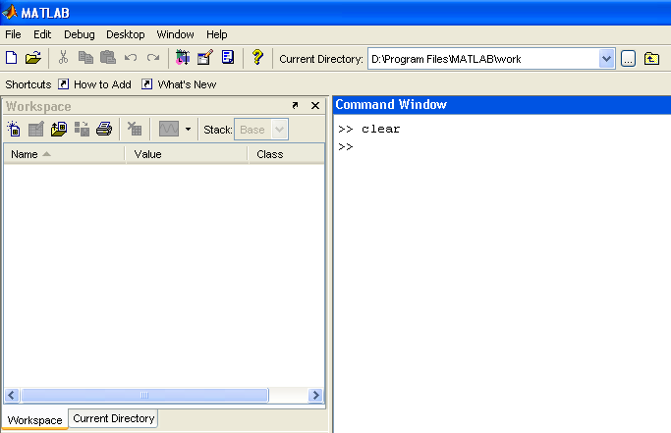
After executing clear Command
After clear function

Slide 14
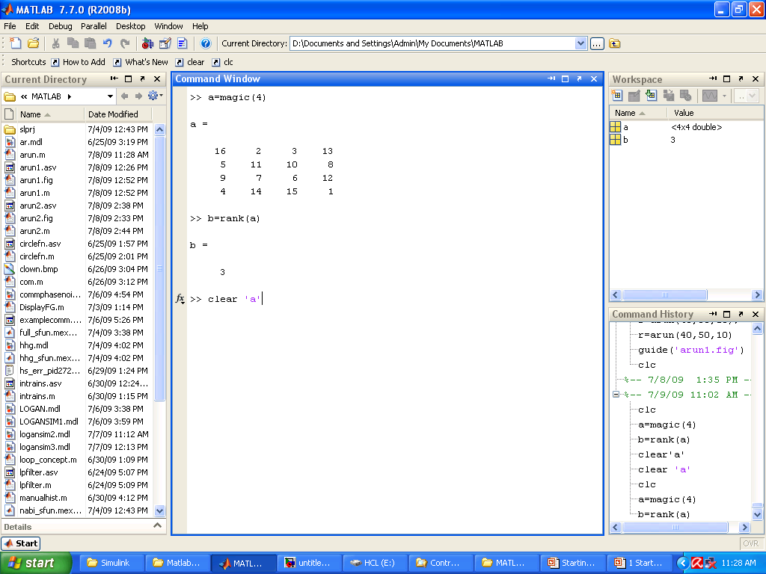
Clear ‘name’
Write a command window
Clear ‘name’ and then press
Enter.

Slide 15

clear name
If name is the name of a function,
the function is cleared in both the function workspace
and in your base workspace.
Removing
Variable ‘a’
From
Workspace

Slide 16
Up arrow (↑) , Semicolon (;) and Ctrl c
Use the up arrow to recall statements used in the command history.
Use semicolon (;) to suppress the display at the command window.
Ctrl C to terminate the execution

Slide 17
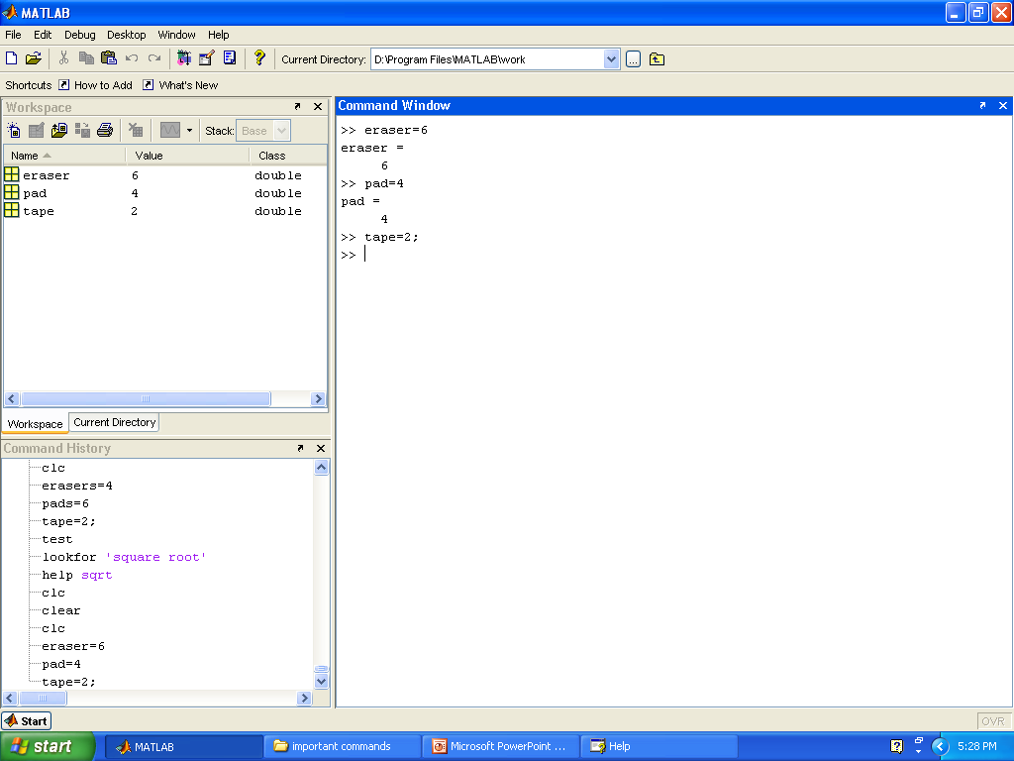
Semicolon ‘;’
Suppress the display

Slide 18
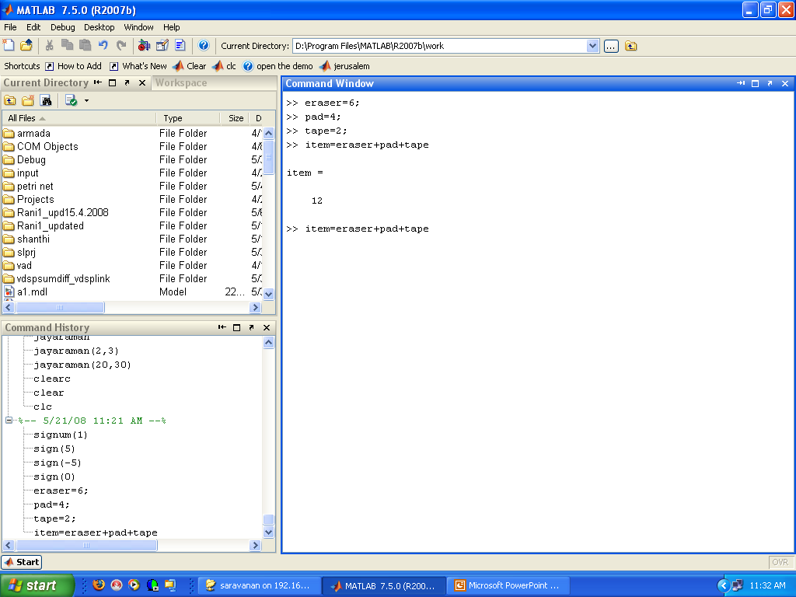
Up arrow to recall statement

Slide 19
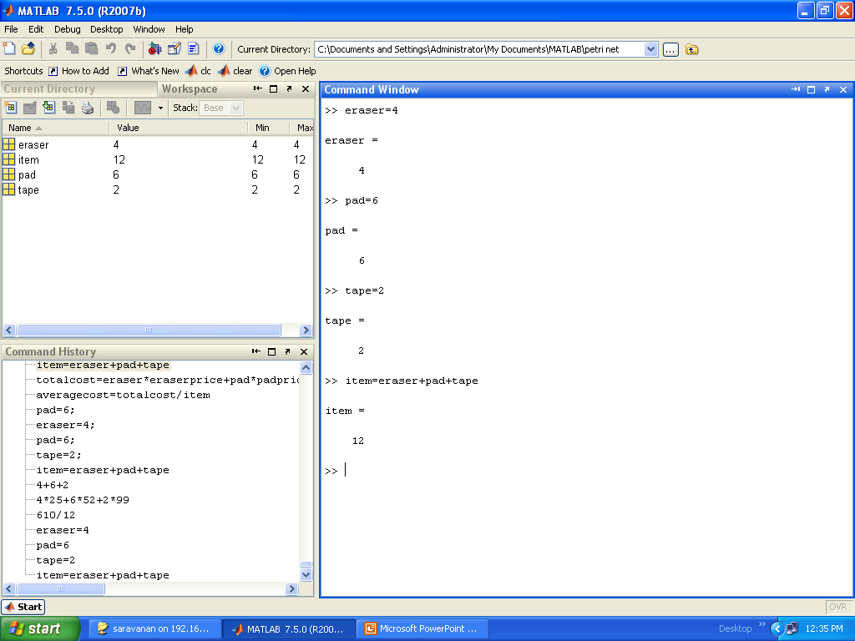
Now let us use Variables in MATLAB
Workspace Window
Variable name
Press Enter

Slide 20
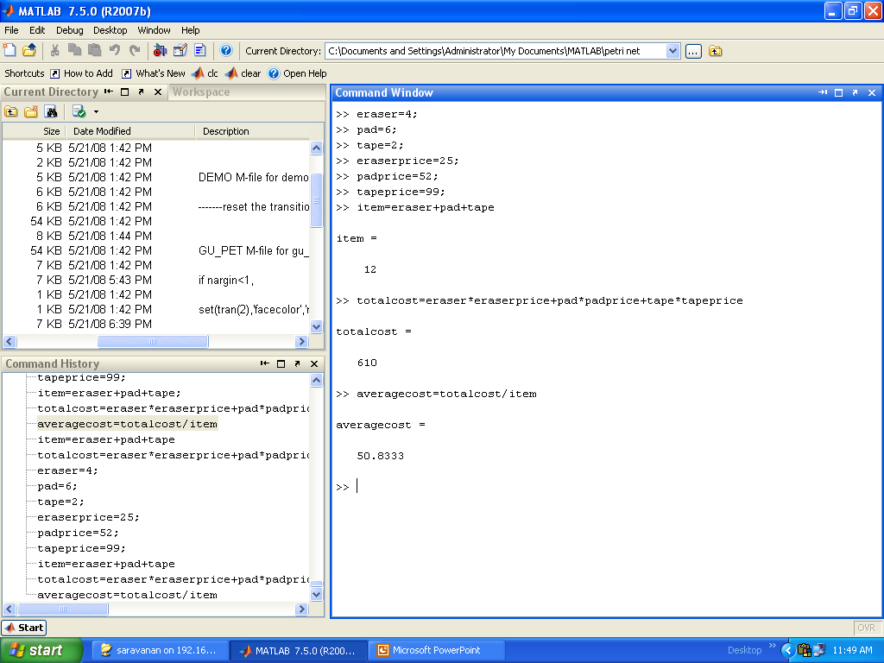
”variable-approach” (Contd..)
Enter Variable Names such as eraser,pad,etc

Slide 21
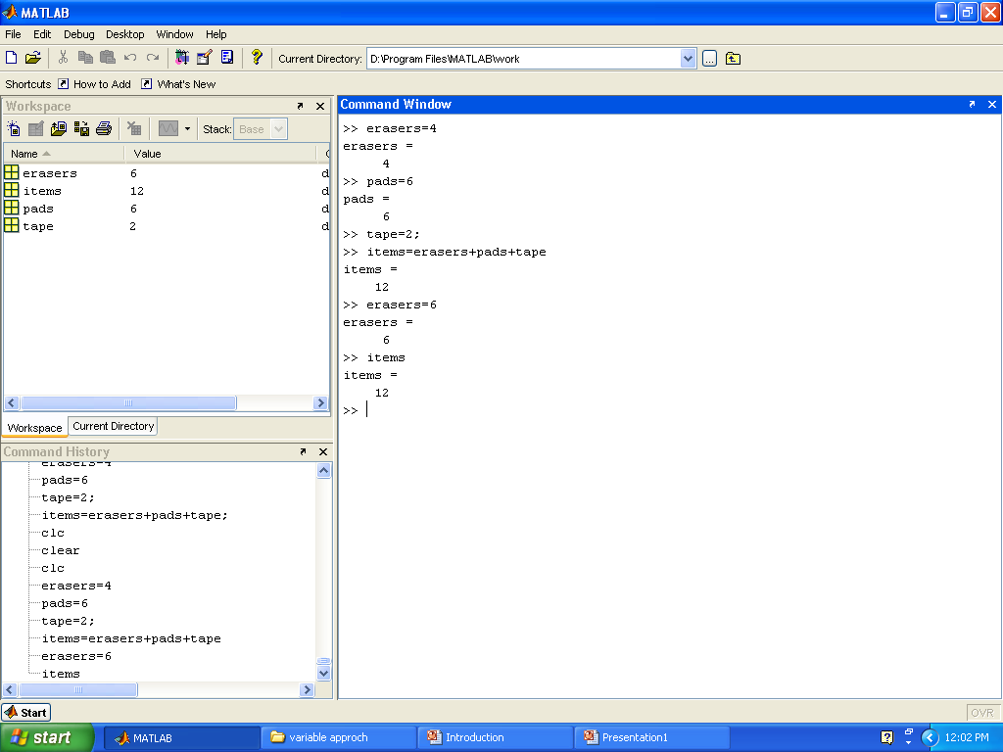
Now even though a new value is given to a variable, the original value of the expression is not changed until the complete expression is executed again
Change the values
No change

Slide 22
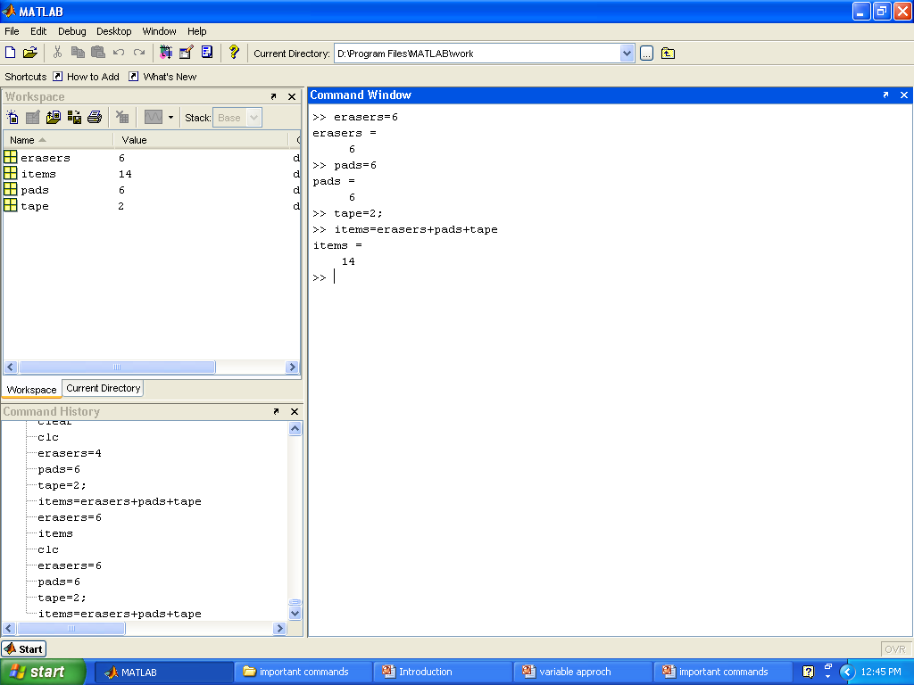
Reevaluate to see the effect
Re execute to see the effect

Slide 23
Predefined Variables
ans : MATLAB automatically stores the
result in variable ‘ans’
pi : The number pi
i : Defined as sqrt(-1)
j : Same as i
inf : Used for infinity
NaN : MATLAB cannot determine a valid
numeric value. For example 0/0.

Slide 24
Variable Declaration in MATLAB
Variable names must be a single word containing no spaces
Variable must start with a letter followed by any number of letters , digits, Underscores.
Punctuation characters are not allowed
Variable length can be up to 63 characters
Key words cannot be used for variables like function, global, for, break, case, switch, if etc…

Slide 25
BASIC COMMANDS IN MATLAB
Arithmetic Operations
Order of Precedence
Math Functions
Trigonometric Math Functions
Predefined Variables

Slide 26
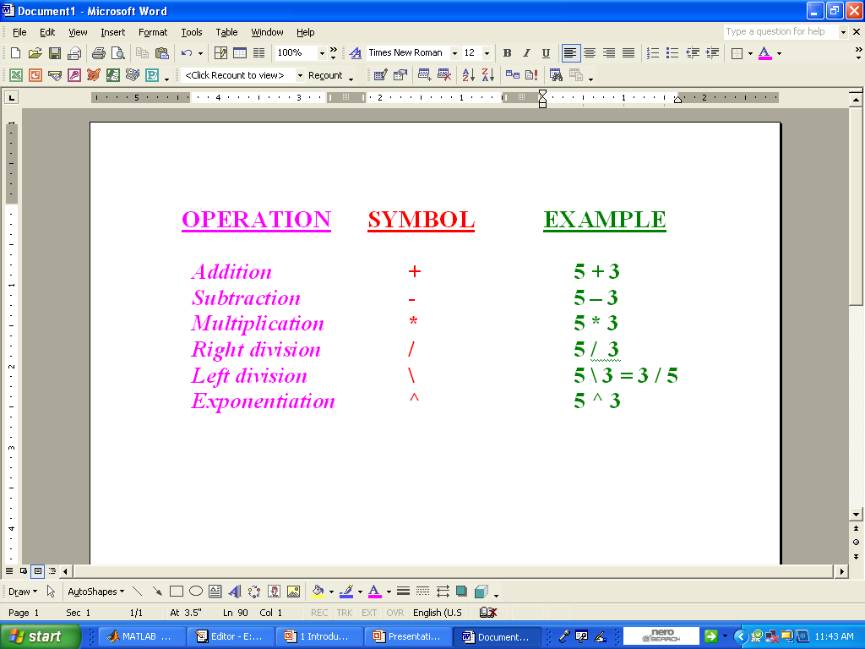
Arithmetic Operators

Slide 27
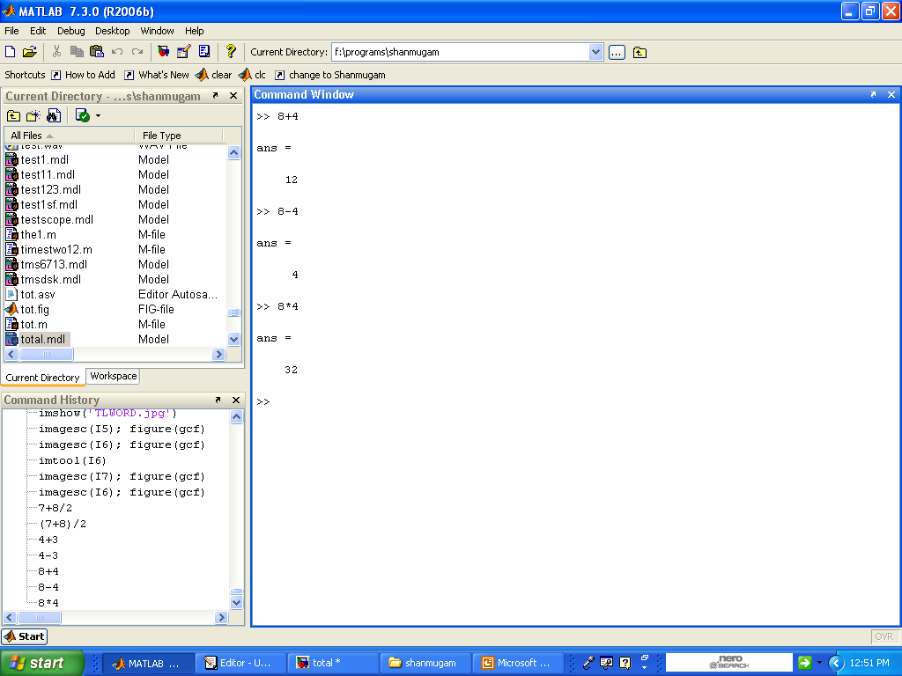
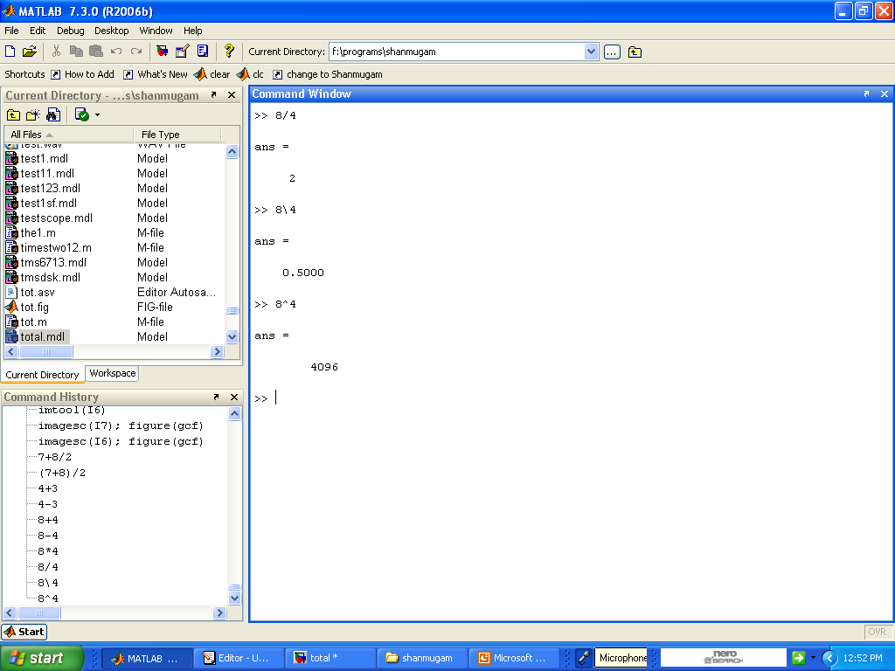
Example:-

Slide 28
Order of Precedence
Precedence Mathematical Operation
First Parentheses.
Second Exponential.
Third Multiplication, Division.
Fourth Addition and Subtraction

Slide 29
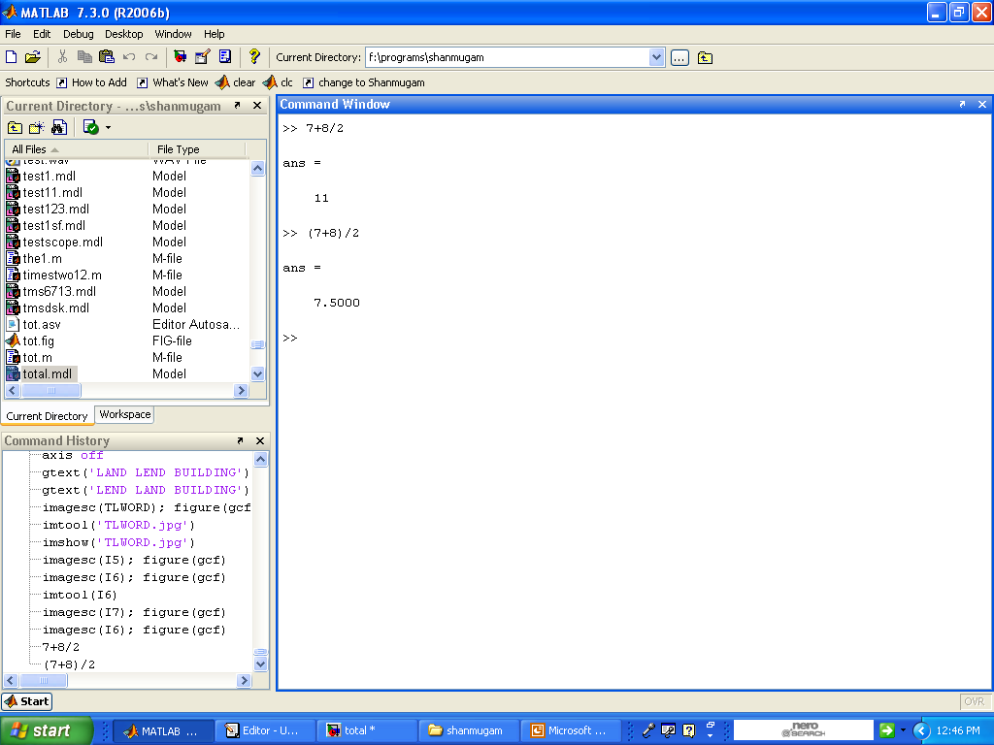
Example:-
8/2 is executed first
7+8 is executed first

Slide 30
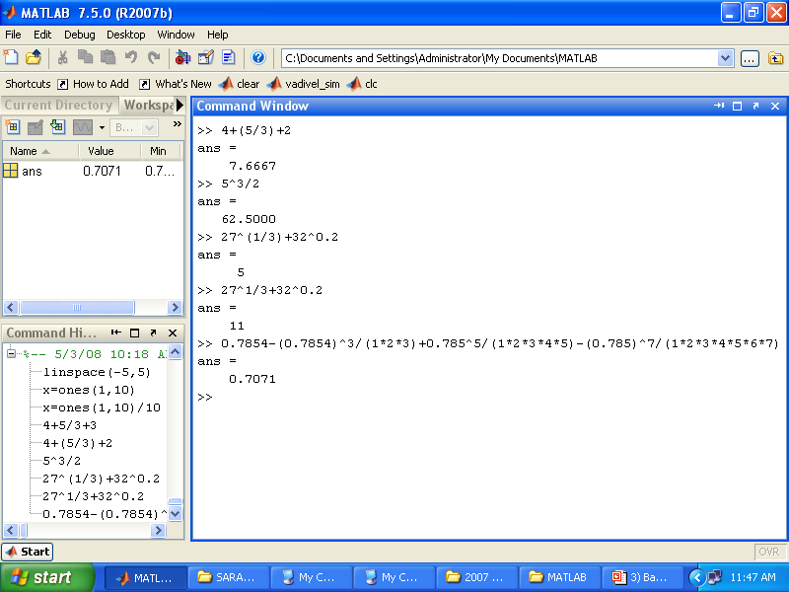
Type and press Enter
5/3 is executed first
5^3 is executed first,/2 is executed next

Slide 31
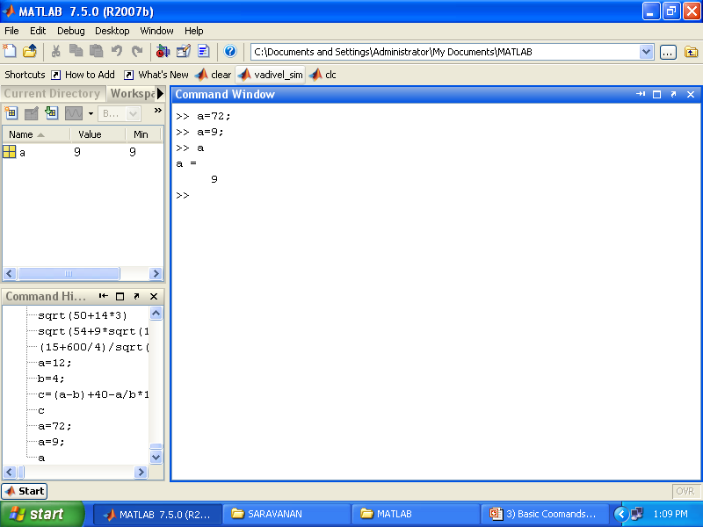
A value of 72 is assigned to the variable a.
A new value of 9 is assigned to the variable a.
The current value of the variable is displayed when the name of the variable is typed and the Enter key is pressed

Slide 32
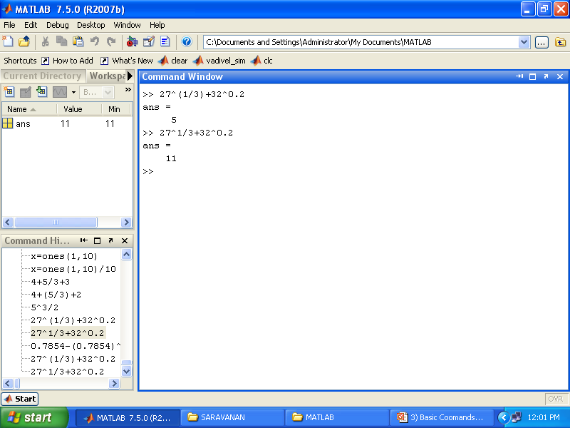
1/3 is executed first,27^(1/3) and 32^0.2 are executed next, and + is executed last
27^1 and 32^0.2 are executed first, and /3 is executed next + is executed last

Slide 33
Mathematical Functions
Function Description
sqrt(x) Square root.
exp(x) Exponential.
abs(x) Absolute value.
log(x) Natural logarithm.
log10(x) Base 10 logarithm
factorial(x) The factorial function x!

Slide 34
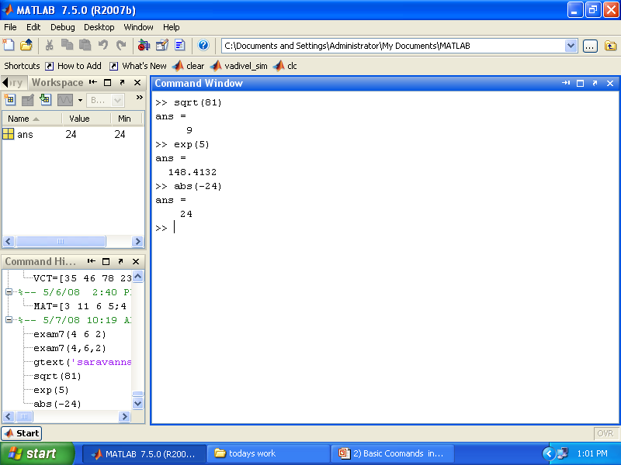
Mathematical Functions
Square root
Exponential (exp)
Absolute value

Slide 35
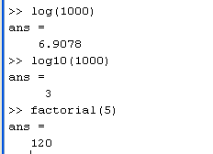
Natural logarithm base e logarithm log(x)
Base 10 logarithm
The factorial function(x)

Slide 36
Trigonometric Functions
Function
sin(x) x→ radians
cos(x)
tan(x)
cot(x)

Slide 37
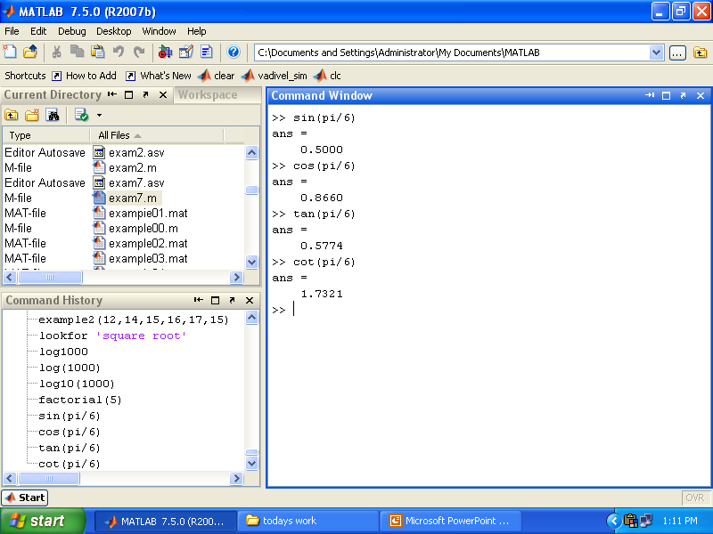
Trigonometric Functions
Sine of angle x (x in radians)
Cosine of angle x (x in radians)
Tangent of angle x (x in radians)
Cotangent of angle x (x in radians)

Slide 38
Example:
cos²(x/2) = (tanx+sinx) / (2tanx)
verify the identity, by calculating each side of equation by substituting x=pi/5.
verify the identity using MATLAB as a Calculator in Command Window

Slide 39
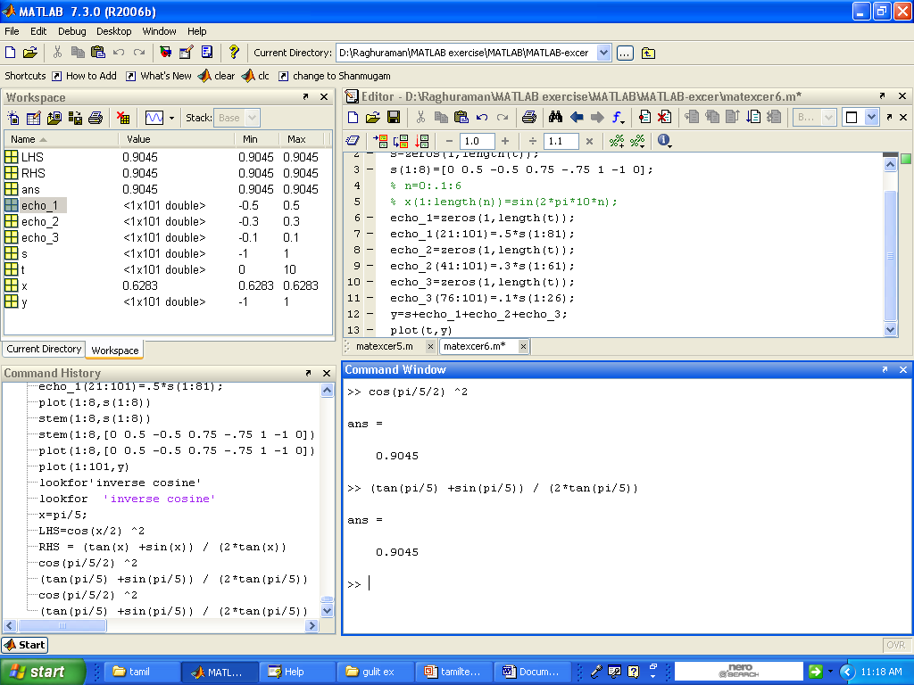

Slide 40
Example
cos²(x/2) = (tanx+sinx) / (2tanx)
verify the identity, by calculating each side of equation by substituting x=pi/5.
Now verify the identity by using variable approach in Command Window

Slide 41
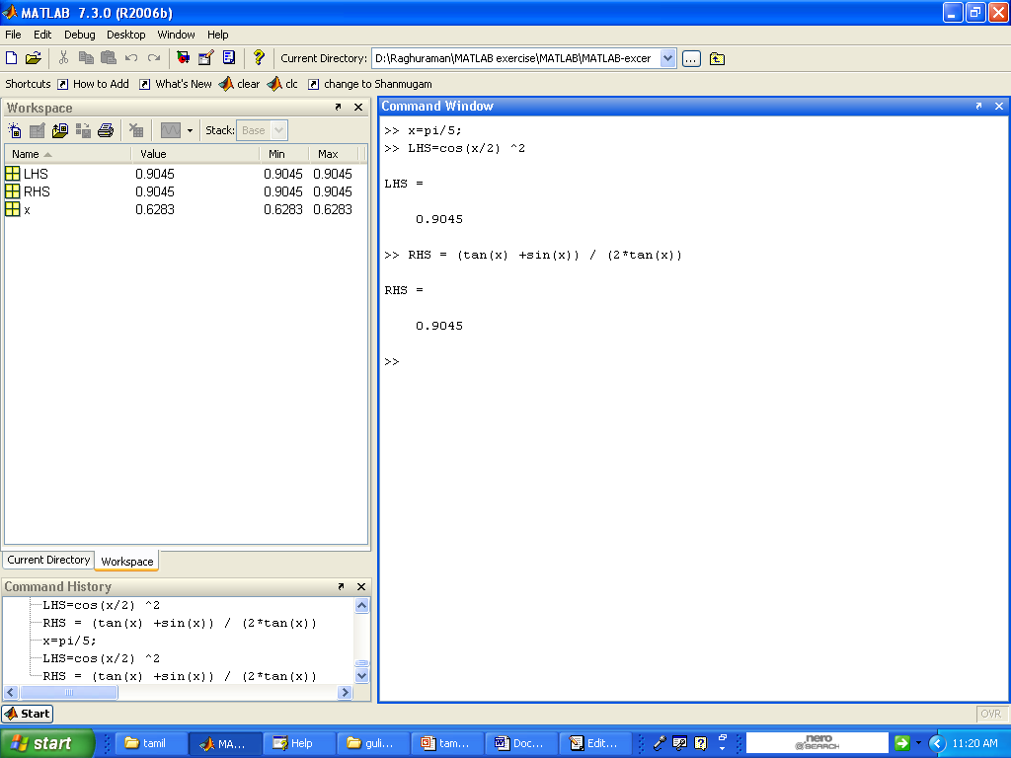

Slide 42
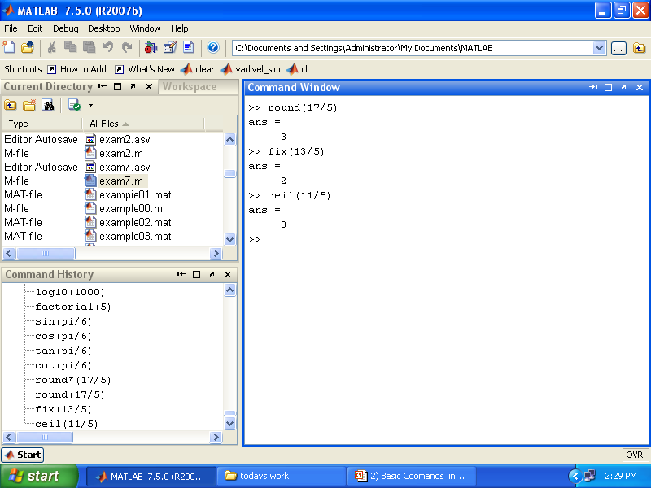
Rounding Functions
Round to nearest integer
Round towards zero
Round towards infinity

Slide 43
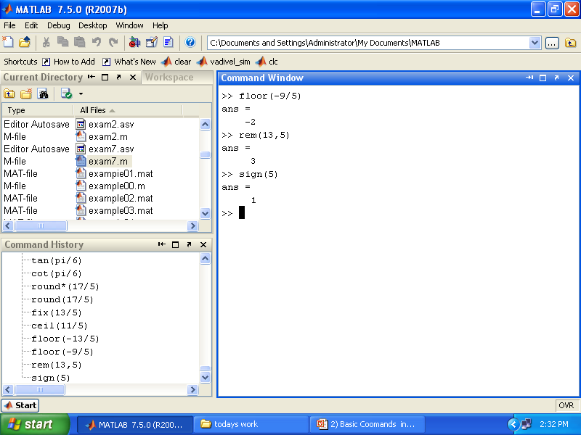
Round towards minus infinity
Returns the remainder after x is divided by y
Signum function Returns 1 if x>0,-1 if x<0,and 0 if x=0

Slide 44
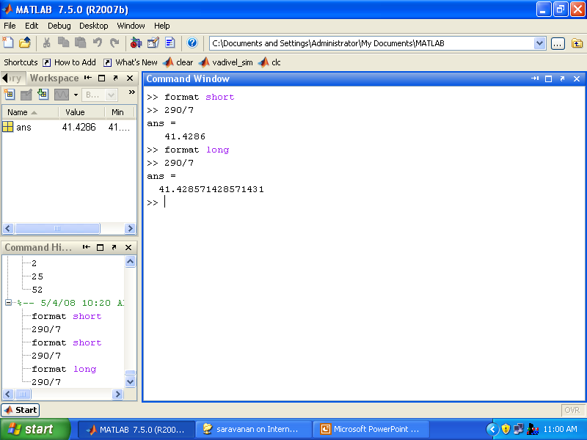
Display Format
Fixed-point with 4 decimal digits for:0.001<number<1000 otherwise display format short e
Fixed-point with 15 decimal digits for:0.001<number<100 otherwise display format long e

Slide 45

Scientific notation with 4 decimal digits
Scientific notation with 15 decimal digits

Slide 46
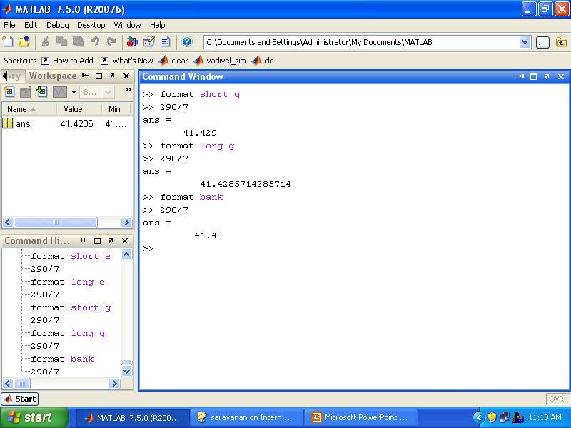
Best of 5-digit fixed or floating point
Best of 13-digit fixed or floating point
Two decimal digits

Slide 47
Examples
Calculate:
a.(2+7)³ +(273)^{2/3}/2 +55²/3
b.cos²(5π/6) sin(7π/8)² + tan(π/6log8)/√7

Slide 48
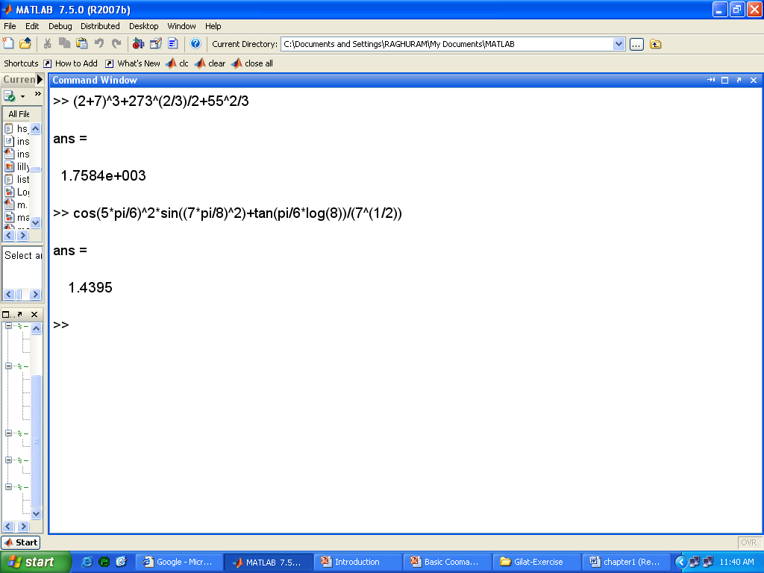
Solution

Slide 49
Thank You

Slide 52
My name is ------------
I am working as a Matlab Programmer & Trainer in Raghuram Associates, Chennai

